Slide 1
Atulya
name: SACHIN
Admission no.: 21JE0794
division: Internet of things

Slide 2
Problem Statement:
Develop an end-to-end IoT-based solution to solve real-world problems in one or more of the following focus areas: Agriculture, Healthcare, Logistics, Asset Tracking, Renewables, Homeland Security, Animal Conservation/Care (Husbandry/Wildlife/Domestic). Example: A tech-based solution for increasing the penetration of healthcare facilities in the rural areas of India.

Slide 3
Weather Monitoring System
Concept:
Different Sensors collect data of different parameters, like temperature, humidity, rain etc.
Send the local data to server and stores it in the database for further use.

Slide 4
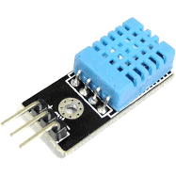
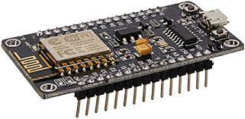
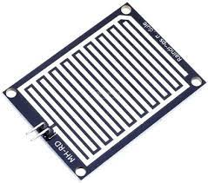
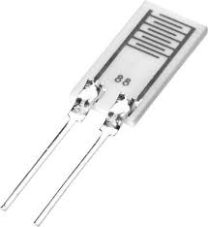
Requirements:
Temperature sensor
Humidity sensor
Rain sensor
Soil moisture sensor
Node mcu
Display

Slide 5
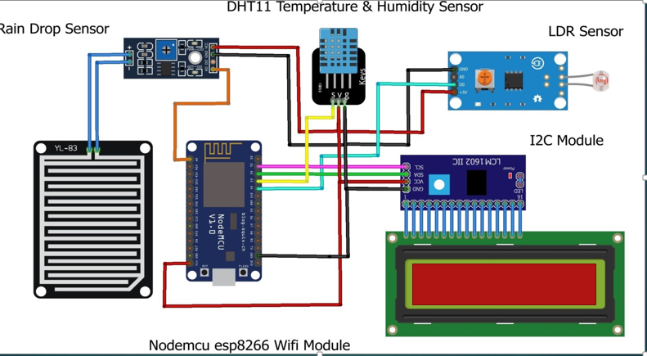
Circuit Diagram :

Slide 6
Working process: block diagram
Rain sensor
NODE MCU
Real Time database
system
Humidity sensor
Temperature Sensor
Power(5v)

Slide 7
Applications:
Temperature data can be collected for various places at various times, so that vegetation of that place can be understood easily.
Moisture data can collected in similar fashion and then it can be decided what to do there and what not to.
Can help in weather forecasting and also helps in analysing the trend of different parameters such as temperature, humidity, etc so that prediction can be made easily.
Also help in understanding and analysing topography of that area.

Slide 8
REFERENCES:
https://www.youtube.com/watch?v=pgOvNURUoT0
https://www.youtube.com/watch?v=1O1kDmfUG68
https://www.youtube.com/watch?v=auTM4S59pgo

Slide 9
Thank You

